Slide 1
Discrete Mathematics generating functions
Liangfeng Zhang
School of Information Science and Technology
ShanghaiTech University

Slide 2
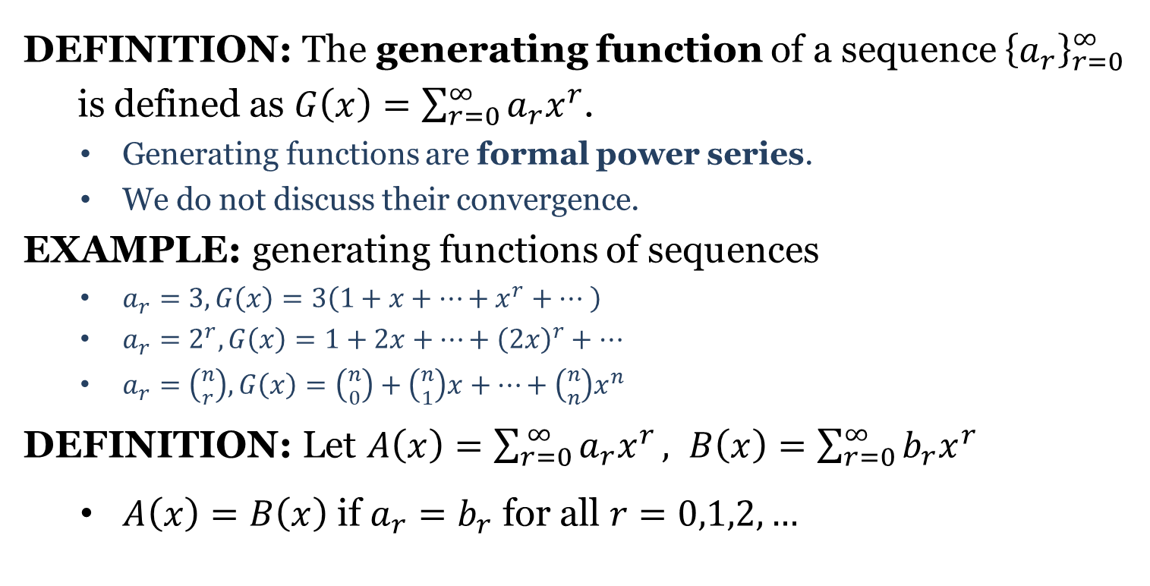
Generating Functions
DEFINITION: The generating function of a sequence ${\left\{a_{r}\right\}}_{r=0}^{∞}$
is defined as $G\left(x\right)=\sum_{r=0}^{∞}{a_{r}x^{r}}$.
Generating functions are formal power series.
We do not discuss their convergence.
EXAMPLE: generating functions of sequences
$a_{r}=3, G\left(x\right)=3\left(1+x+…+x^{r}+… \right)$
$a_{r}=2^{r}, G\left(x\right)=1+2x+…+{\left(2x\right)}^{r}+…$
$a_{r}=\left({n \atop r}\right), G\left(x\right)=\left({n \atop 0}\right)+\left({n \atop 1}\right)x+…+\left({n \atop n}\right)x^{n}$
DEFINITION: Let $A\left(x\right)=\sum_{r=0}^{ ∞}{a_{r}x^{r}}, B\left(x\right)=\sum_{r=0}^{∞}{b_{r}x^{r}}$
$A\left(x\right)=B\left(x\right)$ if $a_{r}=b_{r}$ for all $r=0,1,2,…$

Slide 3
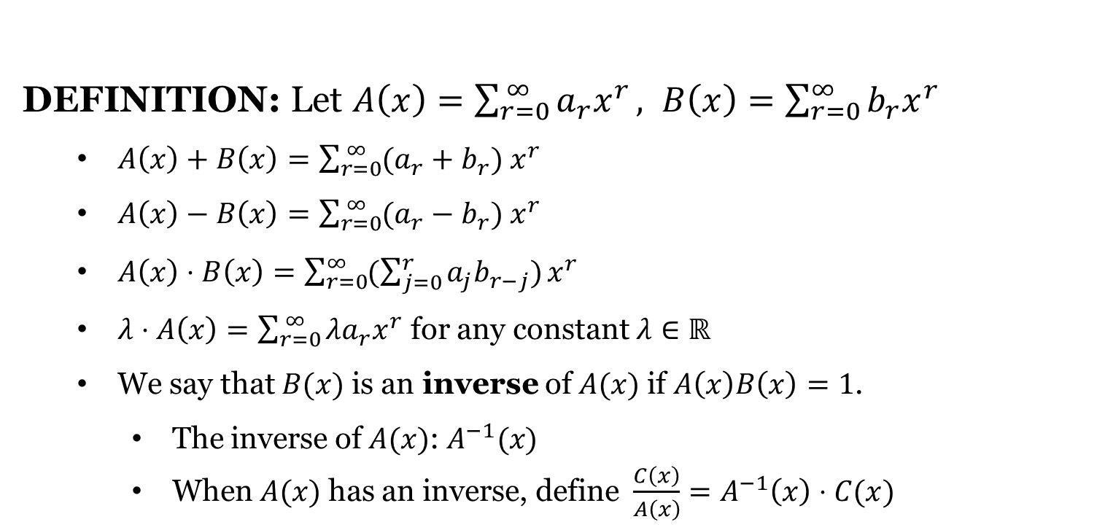
Operations
DEFINITION: Let $A\left(x\right)=\sum_{r=0}^{ ∞}{a_{r}x^{r}}, B\left(x\right)=\sum_{r=0}^{∞}{b_{r}x^{r}}$
$A\left(x\right)+B\left(x\right)=\sum_{r=0}^{ ∞}{(a_{r}+b_{r}){ x}^{r}}$
$A\left(x\right)−B\left(x\right)=\sum_{r=0}^{ ∞}{(a_{r}−b_{r}){ x}^{r}}$
$A\left(x\right)⋅B\left(x\right)=\sum_{r=0}^{∞}{(\sum_{j=0}^{r}{a_{j}b_{r−j}})}x^{r}$
$λ⋅A\left(x\right)=\sum_{r=0}^{ ∞}{{λa}_{r}x^{r}}$ for any constant $λ∈ℝ$
We say that $B(x)$ is an inverse of $A(x)$ if $A\left(x\right)B\left(x\right)=1$.
The inverse of $A(x)$: $A^{−1}(x)$
When $A(x)$ has an inverse, define $\frac{C\left(x\right)}{A\left(x\right)}=A^{−1}\left(x\right)⋅C(x)$

Slide 4
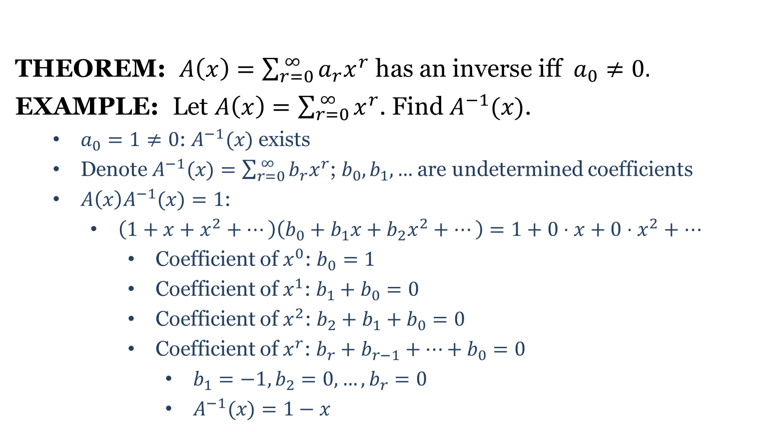
Operations
THEOREM: $A\left(x\right)=\sum_{r=0}^{ ∞}{a_{r}x^{r}}$ has an inverse iff $a_{0}≠0.$
EXAMPLE: Let $A\left(x\right)=\sum_{r=0}^{ ∞}{x^{r}}$. Find $A^{−1}(x)$.
$a_{0}=1≠0$: $A^{−1}(x)$ exists
Denote $A^{−1}(x)=\sum_{r=0}^{ ∞}{{b_{r}x}^{r}}$; $b_{0},b_{1},…$ are undetermined coefficients
$A\left(x\right)A^{−1}(x)=1$:
$\left(1+x+x^{2}+⋯\right)\left(b_{0}+b_{1}x+b_{2}x^{2}+⋯\right)=1+0⋅x+0⋅x^{2}+…$
Coefficient of $x^{0}$: $b_{0}=1$
Coefficient of $x^{1}$: $b_{1}+b_{0}=0$
Coefficient of $x^{2}$: $b_{2}+b_{1}+b_{0}=0$
Coefficient of $x^{r}$: $b_{r}+b_{r−1}+⋯+b_{0}=0$
$b_{1}=−1, b_{2}=0,…,b_{r}=0$
$A^{−1}(x)=1−x$

Slide 5
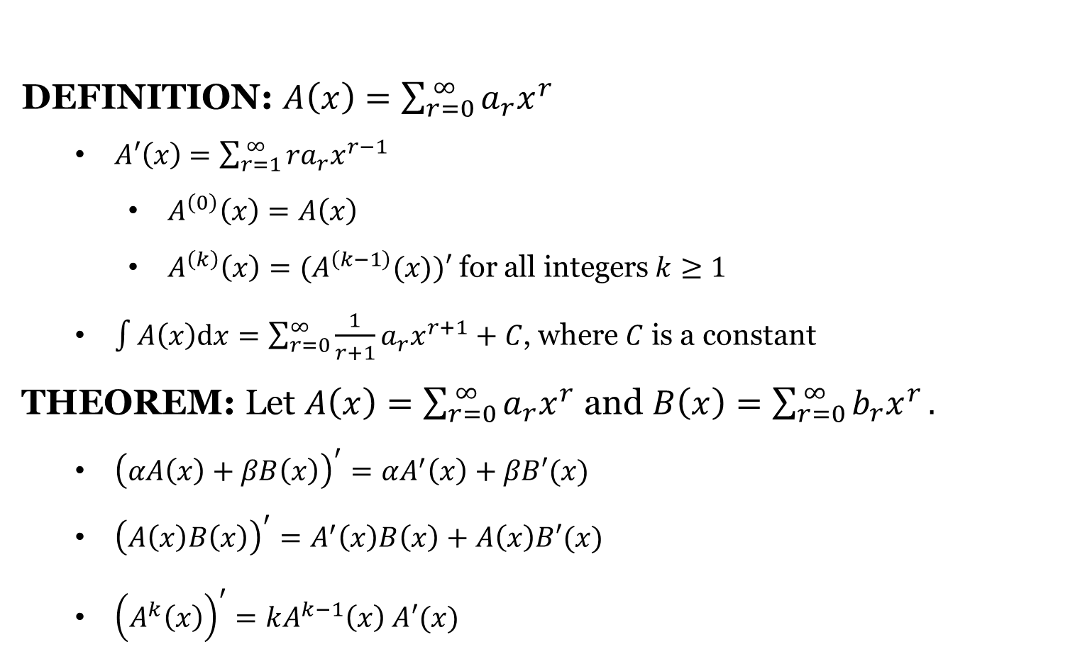
Operations
DEFINITION: $A\left(x\right)=\sum_{r=0}^{ ∞}{a_{r}x^{r}}$
$A′\left(x\right)$ $=\sum_{r=1}^{ ∞}{{ra}_{r}x^{r−1}}$
$A^{\left(0\right)}\left(x\right)=A\left(x\right)$
$A^{\left(k\right)}\left(x\right)=(A^{\left(k−1\right)}(x))′$ for all integers $k≥1$
$\int{A\left(x\right)dx}=\sum_{r=0}^{∞}{\frac{1}{r+1}a_{r}x^{r+1}}+C$, where $C$ is a constant
THEOREM: Let $A\left(x\right)=\sum_{r=0}^{ ∞}{a_{r}x^{r}}$ and $B\left(x\right)=\sum_{r=0}^{ ∞}{b_{r}x^{r}}.$
${\left(αA\left(x\right)+βB\left(x\right)\right)}^{′}=αA^{′}\left(x\right)+βB′(x)$
${\left(A\left(x\right)B\left(x\right)\right)}^{′}=A^{′}\left(x\right)B\left(x\right)+A\left(x\right)B′(x)$
${\left(A^{k}\left(x\right)\right)}^{′}=kA^{k−1}\left(x\right) A′(x)$

Slide 6

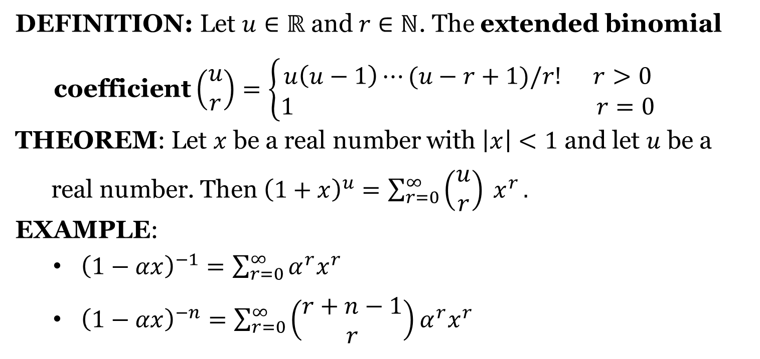
$${\left(1+αx\right)}^{u}$$
DEFINITION: Let $u∈ℝ$ and $r∈ℕ$. The extended binomial
coefficient $\left(\begin{aligned}u \\ r\end{aligned}\right)=\left\{\begin{aligned}u\left(u−1\right)⋯(u−r+1)/r! r>0 \\ 1 r=0\end{aligned}\right.$
THEOREM: Let $x$ be a real number with $\left|x\right|<1$ and let $u$ be a
real number. Then ${\left(1+x\right)}^{u}=\sum_{r=0}^{∞}{\left(\begin{aligned}u \\ r\end{aligned}\right) x^{r}}.$
EXAMPLE:
${\left(1−αx\right)}^{−1}=\sum_{r=0}^{∞}{{α^{r}x}^{r}}$
${\left(1−αx\right)}^{−n}=\sum_{r=0}^{∞}{\left(\begin{aligned}r+n−1 \\ r\end{aligned}\right){α^{r}x}^{r}}$

Slide 8
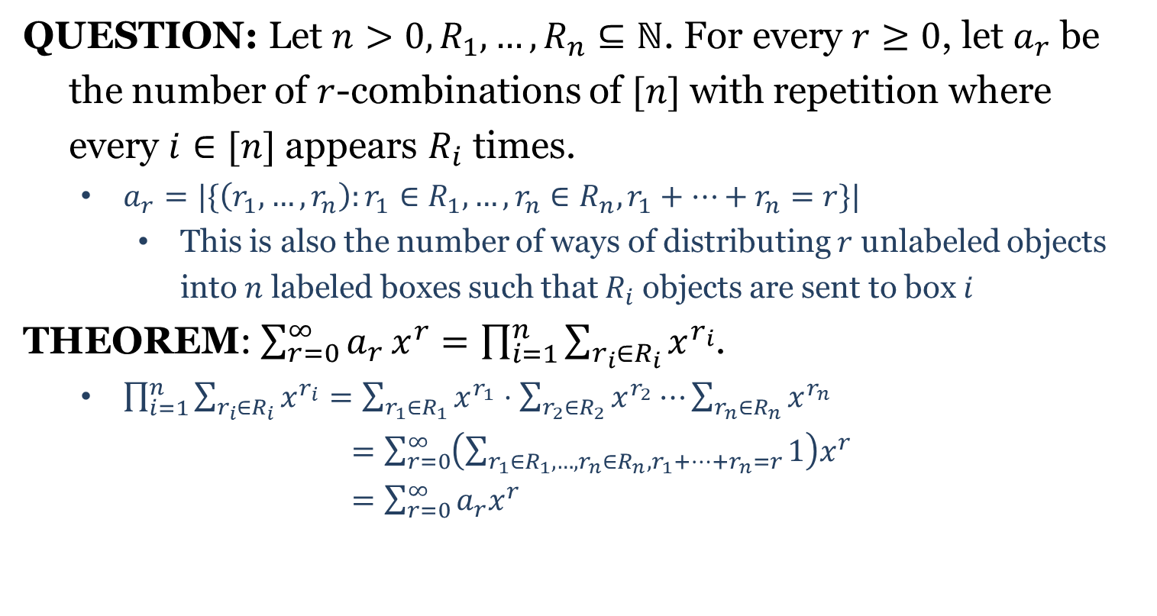
Counting Combinations with GFs
QUESTION: Let $n>0, R_{1},…,R_{n}⊆ℕ$. For every $r≥0$, let $a_{r}$ be
the number of $r$-combinations of $[n]$ with repetition where
every $i∈[n]$ appears $R_{i}$ times.
$a_{r}=|\{\left(r_{1},…,r_{n}\right):r_{1}∈R_{1},…,r_{n}∈R_{n}, r_{1}+⋯+r_{n}=r\}|$
This is also the number of ways of distributing $r$ unlabeled objects into $n$ labeled boxes such that $R_{i}$ objects are sent to box $i$
THEOREM: $\sum_{r=0}^{∞}{a_{r}}x^{r}=\prod_{i=1}^{n}{\sum_{r_{i}∈R_{i}}{x^{r_{i}}}}$.
$\prod_{i=1}^{n}{\sum_{r_{i}∈R_{i}}{x^{r_{i}}}}=\sum_{r_{1}∈R_{1}}{x^{r_{1}}}⋅\sum_{r_{2}∈R_{2}}{x^{r_{2}}}⋯\sum_{r_{n}∈R_{n}}{x^{r_{n}}}$
$=\sum_{r=0}^{∞}{\left(\sum_{r_{1}∈R_{1},…,r_{n}∈R_{n}, r_{1}+⋯+r_{n}=r}{1}\right)x^{r}}$
$=\sum_{r=0}^{∞}{a_{r}x^{r}}$

Slide 9
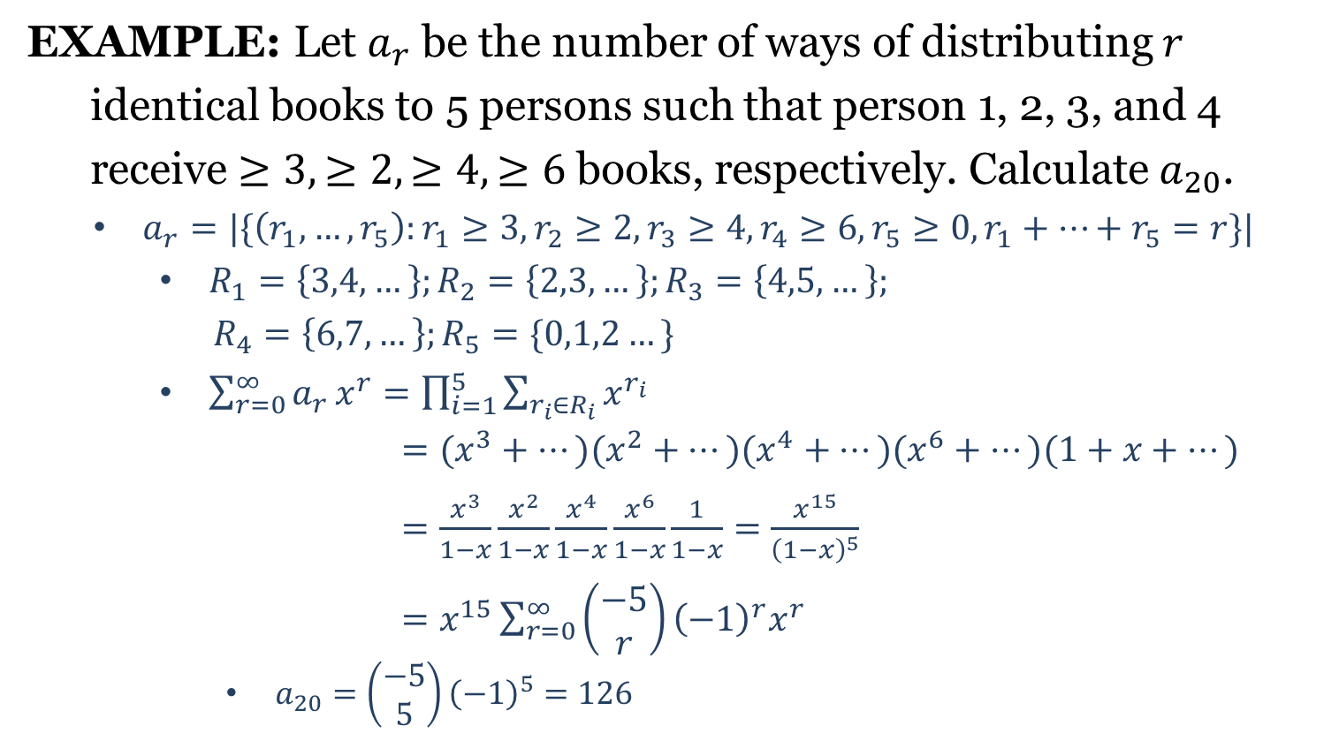
Counting Combinations with GFs
EXAMPLE: Let $a_{r}$ be the number of ways of distributing $r$
identical books to 5 persons such that person 1, 2, 3, and 4
receive $≥3, ≥2, ≥4, ≥6$ books, respectively. Calculate $a_{20}$.
$a_{r}=|\{\left(r_{1},…,r_{5}\right):r_{1}≥3,r_{2}≥2,r_{3}≥4,r_{4}≥6, r_{5}≥0,r_{1}+⋯+r_{5}=r\}|$
$R_{1}=\left\{3,4,…\right\};R_{2}=\left\{2,3,…\right\};R_{3}=\left\{4,5,…\right\};$
$R_{4}=\left\{6,7,…\right\};R_{5}=\{0,1,2…\}$
$\sum_{r=0}^{∞}{a_{r}}x^{r}=\prod_{i=1}^{5}{\sum_{r_{i}∈R_{i}}{x^{r_{i}}}}$
$=(x^{3}+…)(x^{2}+…)(x^{4}+…)(x^{6}+…)(1+x+…)$
$=\frac{x^{3}}{1−x}\frac{x^{2}}{1−x}\frac{x^{4}}{1−x}\frac{x^{6}}{1−x}\frac{1}{1−x}=\frac{x^{15}}{{\left(1−x\right)}^{5}}$
$=x^{15}\sum_{r=0}^{∞}{\left(\begin{aligned}−5 \\ r\end{aligned}\right){{\left(−1\right)}^{r}x}^{r} }$
$a_{20}=\left(\begin{aligned}−5 \\ 5\end{aligned}\right){\left(−1\right)}^{5}=126$

Slide 10
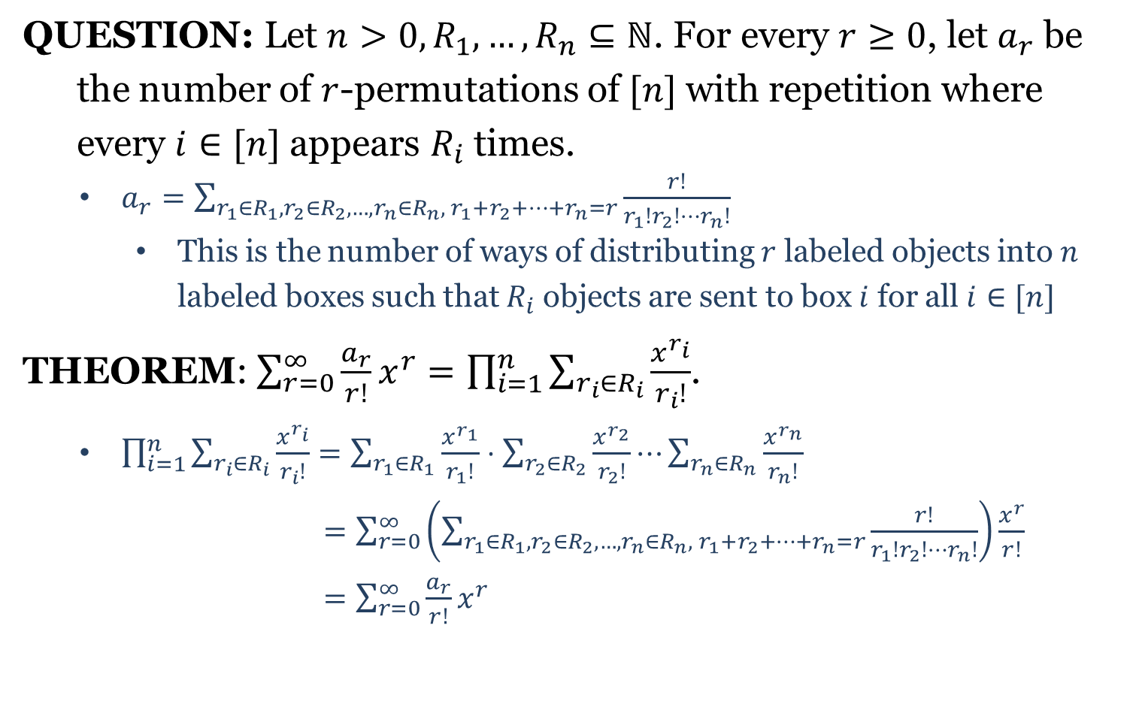
Counting Permutations with GFs
QUESTION: Let $n>0, R_{1},…,R_{n}⊆ℕ$. For every $r≥0$, let $a_{r}$ be
the number of $r$-permutations of $[n]$ with repetition where
every $i∈[n]$ appears $R_{i}$ times.
$a_{r}=\sum_{r_{1}∈R_{1},r_{2}∈R_{2},…,r_{n}∈R_{n}, r_{1}+r_{2}+⋯+r_{n}=r}{\frac{r!}{r_{1}!r_{2}!⋯r_{n}!}}$
This is the number of ways of distributing $r$ labeled objects into $n$ labeled boxes such that $R_{i}$ objects are sent to box $i$ for all $i∈[n]$
THEOREM: $\sum_{r=0}^{∞}{\frac{a_{r}}{r!}}x^{r}=\prod_{i=1}^{n}{\sum_{r_{i}∈R_{i}}{\frac{x^{r_{i}}}{r_{i}!}}}$.
$\prod_{i=1}^{n}{\sum_{r_{i}∈R_{i}}{\frac{x^{r_{i}}}{r_{i}!}}}=\sum_{r_{1}∈R_{1}}{\frac{x^{r_{1}}}{r_{1}!}}⋅\sum_{r_{2}∈R_{2}}{\frac{x^{r_{2}}}{r_{2}!}}⋯\sum_{r_{n}∈R_{n}}{\frac{x^{r_{n}}}{r_{n}!}}$
$=\sum_{r=0}^{∞}{\left(\sum_{r_{1}∈R_{1}, r_{2}∈R_{2},…,r_{n}∈R_{n}, r_{1}+r_{2}+⋯+r_{n}=r}{\frac{r!}{r_{1}!r_{2}!⋯r_{n}!}}\right)}\frac{x^{r}}{r!}$
$=\sum_{r=0}^{∞}{\frac{a_{r}}{r!}}x^{r}$

Slide 11
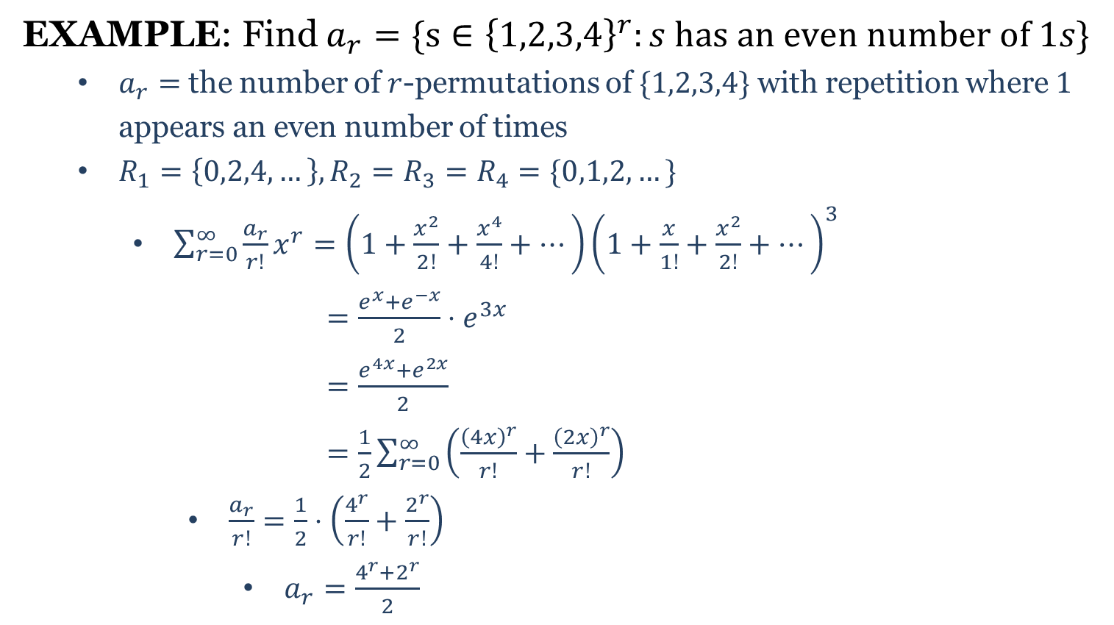
Counting Permutations with GFs
EXAMPLE: Find $a_{r}=\{s∈{\left\{1,2,3,4\right\}}^{r}:s has an even number of 1s\}$
$a_{r}=$ the number of $r$-permutations of $\{1,2,3,4\}$ with repetition where $1$ appears an even number of times
$R_{1}=\left\{0,2,4,…\right\}, R_{2}=R_{3}=R_{4}=\{0,1,2,…\}$
$\sum_{r=0}^{∞}{\frac{a_{r}}{r!}}x^{r}=\left(1+\frac{x^{2}}{2!}+\frac{x^{4}}{4!}+…\right){\left(1+\frac{x}{1!}+\frac{x^{2}}{2!}+⋯\right)}^{3}$
$=\frac{e^{x}+e^{−x}}{2}{⋅e}^{3x}$
$=\frac{e^{4x}+e^{2x}}{2}$
$=\frac{1}{2}\sum_{r=0}^{∞}{\left(\frac{{\left(4x\right)}^{r}}{r!}+\frac{{\left(2x\right)}^{r}}{r!}\right)}$
$\frac{a_{r}}{r!}=\frac{1}{2}⋅\left(\frac{4^{r}}{r!}+\frac{2^{r}}{r!}\right)$
$a_{r}=\frac{4^{r}+2^{r}}{2}$

Slide 13
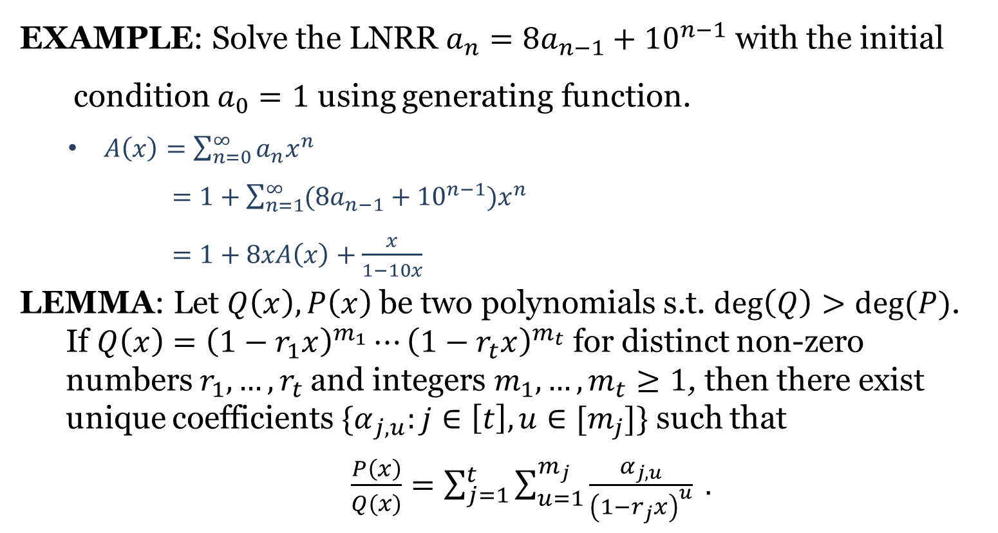
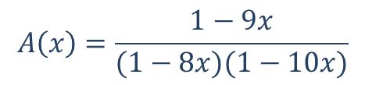
Partial Fraction Decomposition
EXAMPLE: Solve the LNRR $a_{n}=8a_{n−1}+{10}^{n−1}$ with the initial
condition $a_{0}=1$ using generating function.
$A\left(x\right)=\sum_{n=0}^{∞}{a_{n}x^{n}}$
$=1+\sum_{n=1}^{∞}{(8a_{n−1}}+{10}^{n−1})x^{n}$
$=1+8xA\left(x\right)+\frac{x}{1−10x}$
LEMMA: Let $Q\left(x\right), P\left(x\right)$ be two polynomials s.t. $\deg\left(Q\right)>deg⁡(P)$.
If $Q\left(x\right)={\left(1−r_{1}x\right)}^{m_{1}}⋯{\left(1−r_{t}x\right)}^{m_{t}}$ for distinct non-zero
numbers $r_{1},…,r_{t}$ and integers $m_{1},…,m_{t}≥1$, then there exist
unique coefficients ${\{α}_{j,u}:j∈\left[t\right], u∈[m_{j}]\}$ such that
$\frac{P\left(x\right)}{Q(x)}=\sum_{j=1}^{t}{\sum_{u=1}^{m_{j}}{\frac{α_{j,u}}{{\left(1−r_{j}x\right)}^{u}} }}.$
$$A\left(x\right)=\frac{1−9x}{(1−8x)(1−10x)}$$

Slide 14
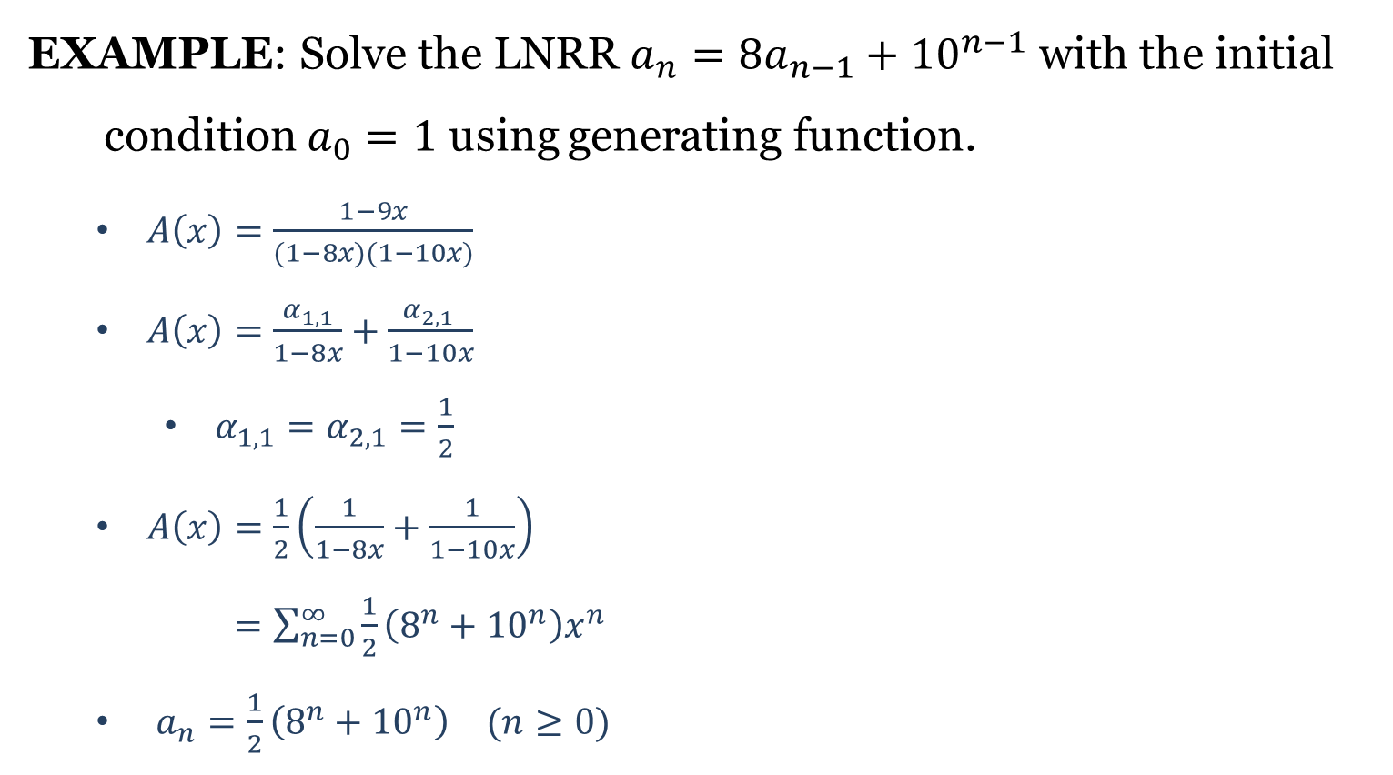
Solving LNRR with GFs
EXAMPLE: Solve the LNRR $a_{n}=8a_{n−1}+{10}^{n−1}$ with the initial
condition $a_{0}=1$ using generating function.
$A\left(x\right)=\frac{1−9x}{(1−8x)(1−10x)}$
$A\left(x\right)=\frac{α_{1,1}}{1−8x}+\frac{α_{2,1} }{1−10x}$
$α_{1,1}=α_{2,1}=\frac{1}{2}$
$A\left(x\right)=\frac{1}{2}\left(\frac{1}{1−8x}+\frac{1}{1−10x}\right)$
$=\sum_{n=0}^{∞}{\frac{1}{2}\left(8^{n}+{10}^{n}\right)x^{n}}$
$a_{n}=\frac{1}{2}\left(8^{n}+{10}^{n}\right)$ $(n≥0)$

